Slide 1

Securing VMware with Secure Boot
Implementing UEFI Secure Boot for VMware ESXi on Dell & Cisco Systems

Slide 2


Intro
About Me:
Russell Hamker
16+ years Running VMware
VCP5-2022
Employer – Dish Wireless
Title – VMware Enterprise Architect
vExpert – 11 years and running
VMUG Leader – Wichita KS
Twitter - @butch7903
Tanzu Vanguard
https://linktr.ee/russellhamker

Slide 3
Why Secure Boot Matters
The Foundation of Modern Infrastructure Security

Slide 4

"Secure Boot isn't just about a checkbox; it's about defining the integrity of the ground upon which your entire infrastructure stands."
— vSphere Security Best Practices

Slide 5

The "WHY": Mitigating Boot-Time Risks
Combatting Rootkits
Enforcing VIB Integrity
Secure Boot prevents unauthorized code from executing during the boot sequence. This stops rootkits and bootkits from nesting beneath the OS layer where traditional antivirus cannot reach.
ESXi requires all VSphere Installation Bundles (VIBs) to be cryptographically signed. Secure Boot enforces this policy, ensuring that only trusted, unaltered drivers and kernels are loaded.

Slide 6
Secure Boot Impact
Zero Compromise
100%
Once enabled, the hypervisor refuses to load any package that does not match the cryptographic signatures in the UEFI database. This provides absolute assurance that the kernel and drivers remain as the vendor intended, drastically reducing the attack surface of the physical host.
Signed Driver Enforcement

Slide 7
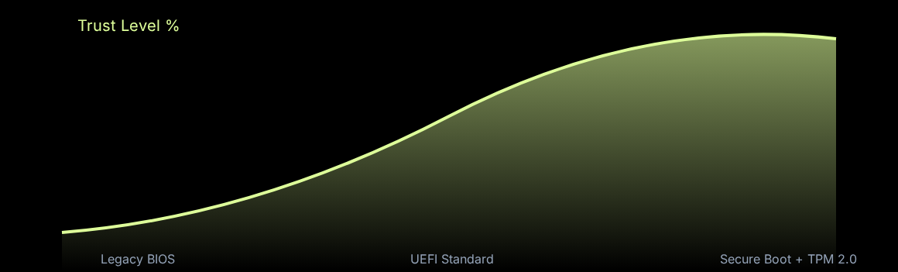
The Value of Hardware ROOT of Trust
A combination of UEFI Secure Boot and TPM 2.0 creates a non-bypassable hardware-backed security posture.

Slide 8





Hardware Prerequisites
TPM 2.0
UEFI Support
Signed VIBs
Highly recommended for hardware-based root of trust and attestation services in vCenter.
Server must be configured in UEFI mode. Legacy BIOS mode is incompatible with Secure Boot.
All installed community-supported or custom drivers must be replaced with signed equivalents.

Slide 9






Dell Secure Boot Operation Modes
User Mode
Audit Mode
Deployed Mode
Platform Key (PK) is installed. Signature verification is performed on programmatic policy updates. Allows unauthenticated transitions between modes.
No PK present. Logs results in Execution Information Table but executes images even if verification fails. Essential for identifying working sets of policy objects.
Most Secure. PK must be installed. Enforces strict signature verification and restricts programmatic mode transitions to protect boot integrity.

Slide 10
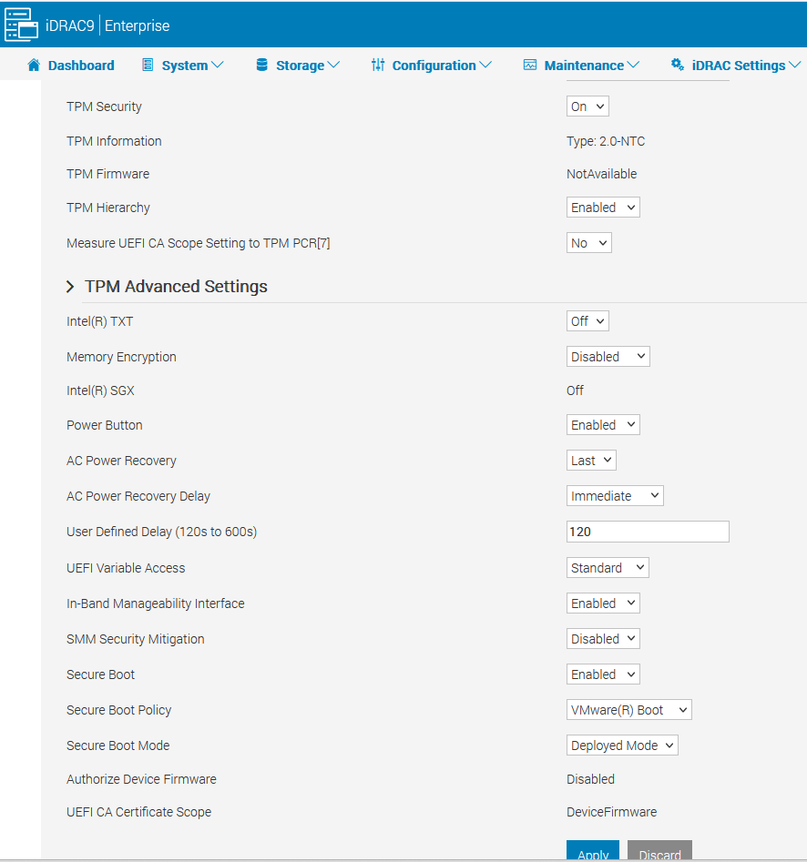

Dell PowerEdge Configuration
BIOS Entry: Press F2 during POST to enter System Setup.
Boot Settings: Set 'Boot Mode' to UEFI.
Security Settings: Navigate to System Security > Secure Boot.
Enable: Set Secure Boot to 'Enabled' and Policy to 'Standard'.
Remote Management: Use iDRAC Configuration > BIOS Settings for headless setup.

Slide 11
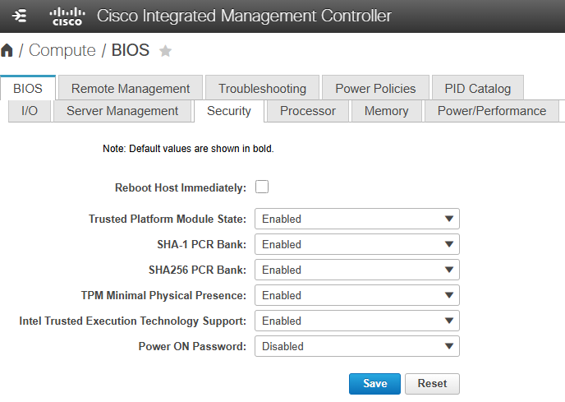
Cisco UCS Configuration
CIMC/GUI: Log in and navigate to the Compute > BIOS tab.
Boot Order: Ensure the Boot Policy is set to UEFI mode.
BIOS Options: Navigate to Advanced > Boot Options.
Enabling: Set 'UEFI Secure Boot' to Enabled.
Deployment: Re-associate the Service Profile to push settings to blades.

Slide 12
Security Feature Matrix
Feature | Standard Boot | UEFI Secure Boot | Secure Boot + TPM 2.0
Rootkit Prevention | No | Yes | Yes
VIB Signature Check | No | Yes | Yes
Remote Attestation | No | No | Yes
Root of Trust | None | Software (UEFI) | Hardware (TPM)

Slide 13
Compliance Standards
Implementing Control ID: VMW-ESXI-01125

Slide 14
REFERENCE: VMW-ESXI-01125
Control ID | Standard Requirement | Technical Rationale
VMW-ESXI-01125 | The ESXi host must enable UEFI Secure Boot. | Prevents unauthorized code/rootkits from loading during boot.
Enforcement | Mandatory for VCF 4.5+ | Ensures end-to-end chain of trust from BIOS to Hypervisor.
Action | Evacuate & Reboot | Host must be in Maintenance Mode for permanent enforcement.

Slide 15

Implementation Workflow
Evacuate
BIOS
Automate
Backup
Verify
Maintenance Mode
Set UEFI/TPM
Run Set-SB Script
Export Recovery Keys
Attestation Check

Slide 16
Recovery Impact
0%
Backup Strategy
By using the PowerCLI Backup script, the risk of losing encryption persistence during hardware swaps is effectively eliminated. This ensures a seamless recovery process for encrypted hosts without manual key re-entry.
Data Loss Risk

Slide 17
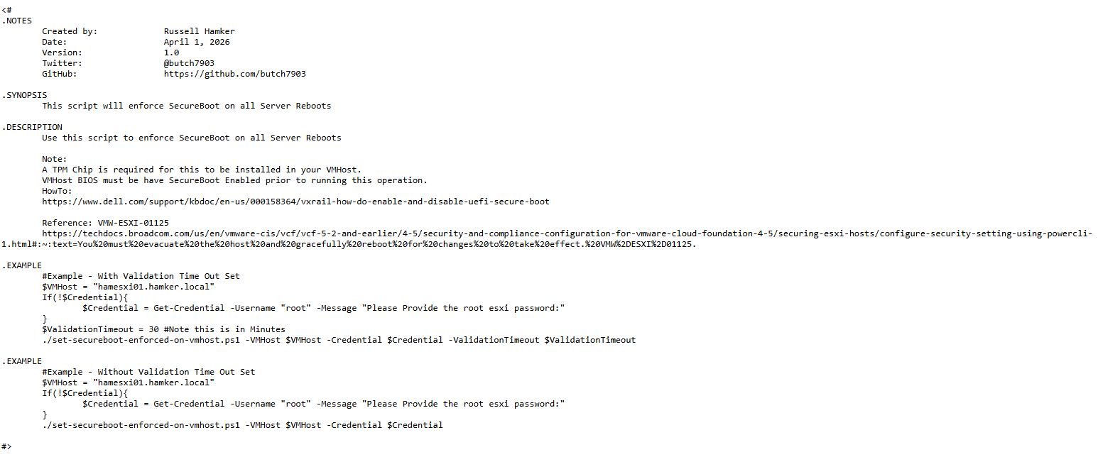

Enforce SecureBoot for a VMHost
set-secureboot-enforced-on-vmhost
This script automates the transition from UEFI-only to Secure Boot Enforced mode across a target host or cluster.
Validates UEFI capability before setting.
Configures requiresecureboot settings.
Ensures compliance with VMW-ESXI-01125.
GitHub: butch7903/PowerCLI repo.
https://github.com/butch7903/PowerCLI/blob/master/Set-Secureboot-Enforced-on-VMHost/set-secureboot-enforced-on-vmhost.ps1

Slide 18
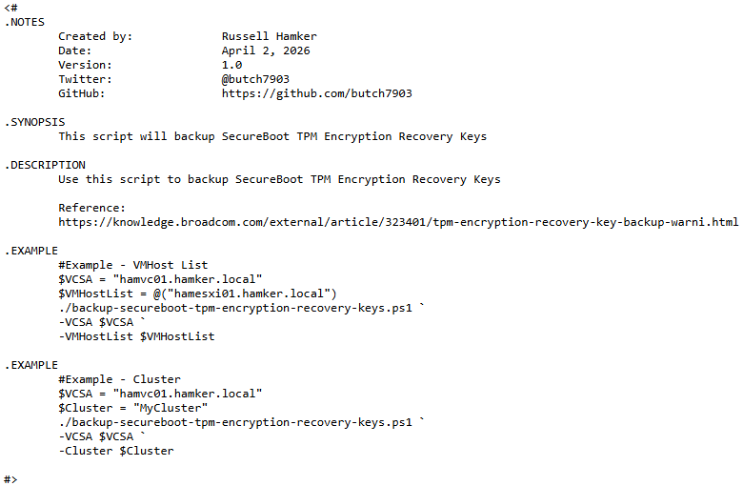
Backup TPM Encryption Keys
backup-secureboot-tpm-encryption-recovery-keys
This script automates the backup of the SecureBoot TPM Encryption Recovery Keys
Specify 1 hosts or a cluster
Exports Keys to CSV
Ensures keys are stored somewhere should you need them
GitHub: butch7903/PowerCLI repo.
https://github.com/butch7903/PowerCLI/blob/master/Backup-Secureboot-TPM-Encryption-Recovery-Keys/backup-secureboot-tpm-encryption-recovery-keys.ps1

Slide 19
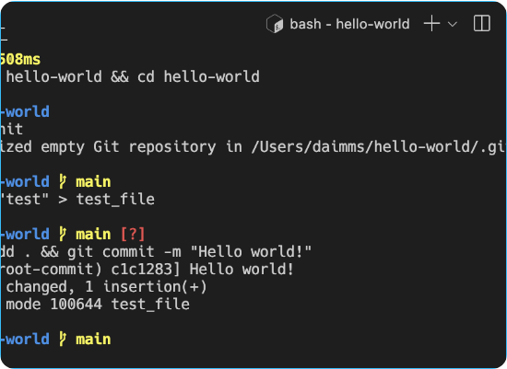
Verification via ESXI Shell
Validation Check: Run /usr/lib/vmware/secureboot/bin/secureboot.py -c to see if the host is ready for Secure Boot.
Status Check: Use /usr/lib/vmware/secureboot/bin/secureboot.py -s to confirm active enforcement.
Host Attestation: Check vCenter > Monitor > Security to view TPM attestation status.

Slide 20
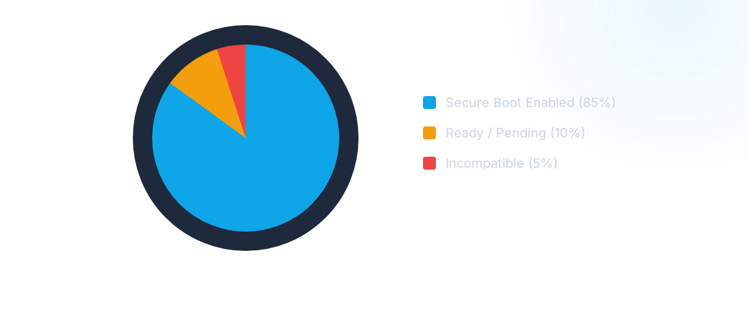
Fleet Complaince Standards
Strategic goal: 100% compliance for all production Tier-1 clusters to meet Regulatory Security Frameworks (PCI-DSS, HIPAA).

Slide 21


Troubleshooting: THE "PURPLE SCREEN"
Signature Mismatch PSOD
Resolution Steps
If ESXi detects an unsigned VIB (e.g., an old RAID driver or community network driver), it will halt with a Purple Screen of Death (PSOD) to prevent potential execution of malware.
Disable Secure Boot in BIOS temporarily. Identify the offending VIB using esxupdate.log. Remove or update the VIB to a signed version, then re-enable Secure Boot.

Slide 22

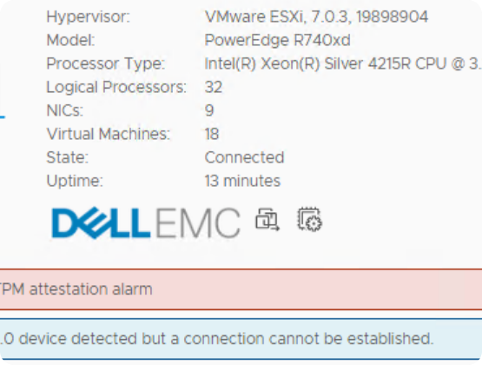
Fixing TPM 2.0 Connection Alerts
"Connection cannot be established"
Often seen in vCenter when a host detects TPM 2.0 but fails to communicate. This is typically a BIOS misconfiguration or mismatched algorithm.
Set TPM Algorithm to SHA-256 (not SHA-1).
Enable TPM 2.0 and "Clear TPM" if attestation fails.
Bypass Physical Presence Interface (PPI) for automation.

Slide 23

Questions?
Next Steps: Audit your hardware inventory for UEFI/TPM compatibility before cluster-wide rollout.

